Slide 1
Attendee Guide
V 1.0 – Train the Trainer

Slide 2
Today's Agenda
9:00 - 9:20: Arrival & Kick-off
9:20 - 9:40: Introduction to the Hackathon
9:40 - 12:00: Challenges/Hacking
12:00 - 13:00: Lunch break
13:00 - 15:30: Challenges/Hacking
15:30 - 15:45: Coffee break
15:45 - 17:30: Challenges/Hacking
17:30 - 17:45: Close & Feedback
17:45 - 19:00: Apéro

Slide 3
Welcome to the It’s a RAG! Hackathon
What is It’s a RAG! Hackathon?
What are the objectives?
What are the pre-requirements
Tips and Tricks to be successful
Challenges overview

Slide 4

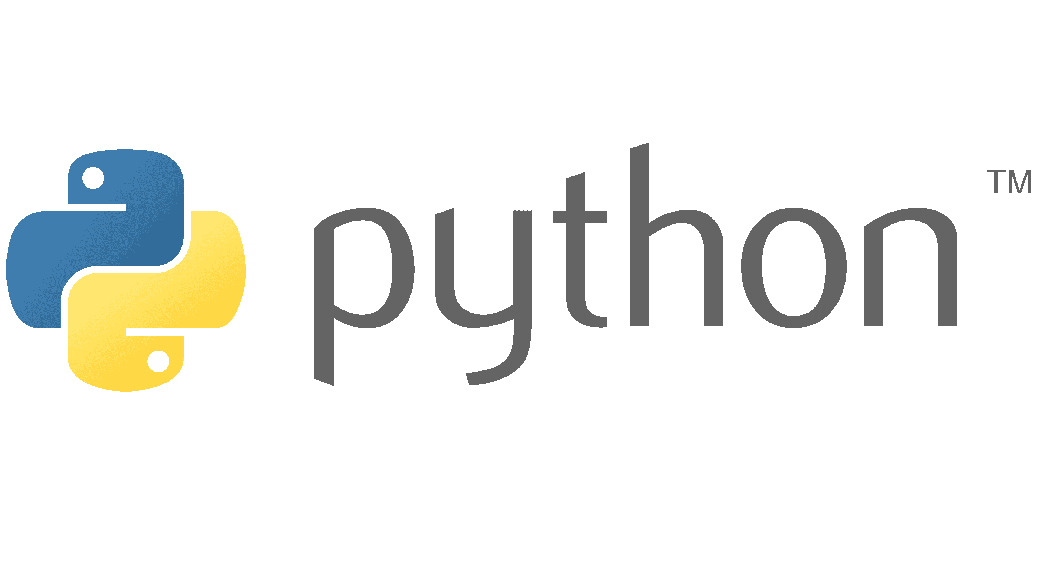

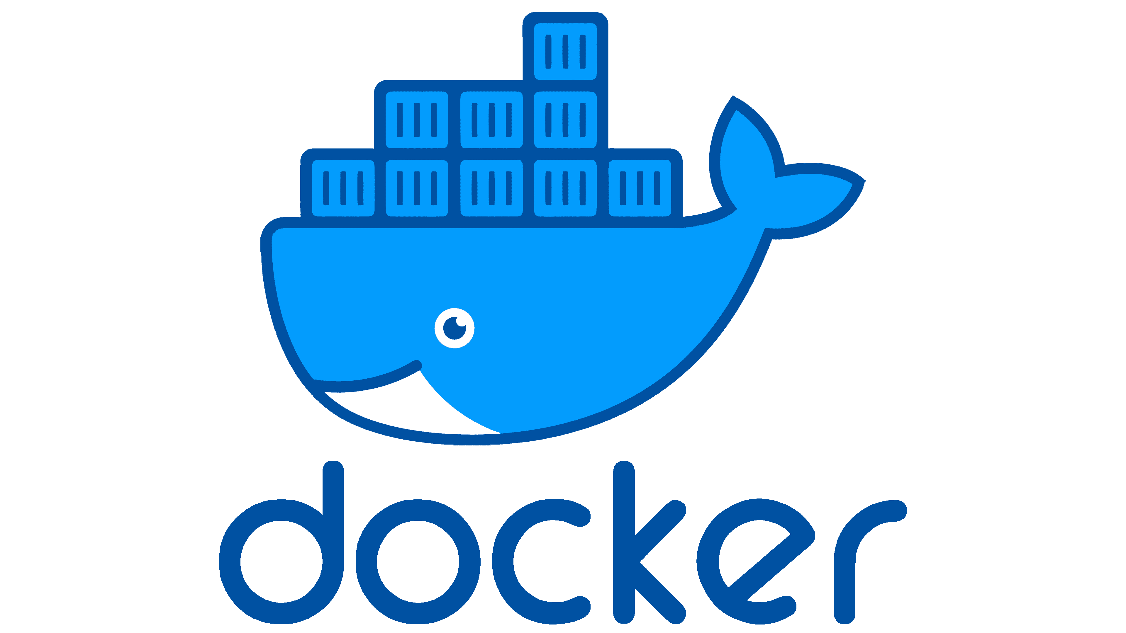

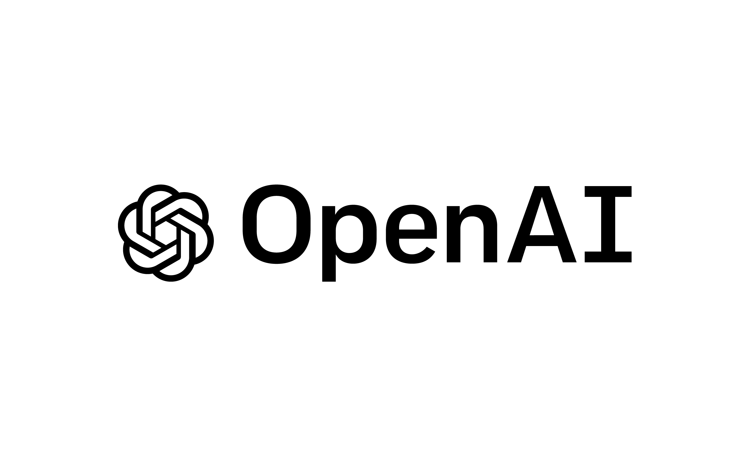

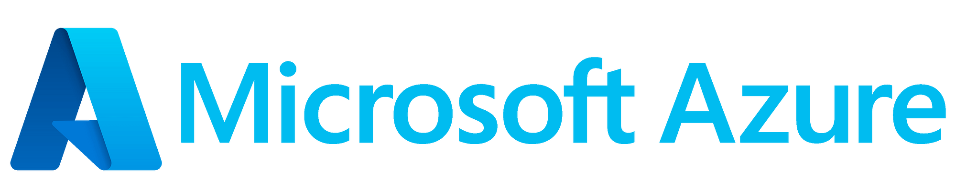
It’s a RAG! Hackathon
It’s a RAG! is semi-guided 1-day Hackathon that leads the participants to create a multi-agent AI solution including:
An Advanced Multi-model RAG Agent on PDFs
A SQL Agent to retrieve information from structured data
An Action Agent to perform API calls on behalf of the user
This solution will run on top of Microsoft Azure platform and will benefit from many Azure services like:
Azure AI Search
Azure Open AI
Azure SQL DB
Azure AI Document Intelligence
Azure Container Apps

Slide 5
Objectives
Get practical knowledge of the building blocks of a GenAI Solution
Understand different techniques to improve efficiency for RAG Applications
Create a working end-to-end solution which can be reuses and adapted to different use cases
Create scaffold to be reused for additional use cases

Slide 6
Pre-requirements
To be successful in this hackathon you need the following skills:
To have basic knowledge of AI Concepts
To have basic knowledge of Microsoft Azure
To be proficient in Python
To be proficient with Docker and application containerization
You also need the following “tools”:
An Azure Subscription (Contributor + User Access Administrator)
A GitHub account
A Docker account
Visual Studio Code
Windows / Mac (x64 or ARM64) machine with possibility to install software

Slide 7
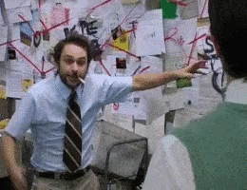
Tips and tricks
Challenges are designed to be completed in sequence
Challenges will become more and more complex
READ the instructions (also the resources!)
If you get stuck somewhere, work within the team to solve it
If you are stuck and frustrated, talk with the coach! ☺

Slide 8


Challenges Overview
Challenge 0 – Learn the Basics
Challenge 1 – Establish your Plan
Challenge 2 – Play with Azure AI Foundry
Challenge 3 – Start Coding
Challenge 4 – Advanced RAG
Challenge 5 – Multi-Source / Multi-Agent
Challenge 6 – Actions
Challenge 7 – Deploy your App

Slide 9
Dataset
FSI

Slide 10
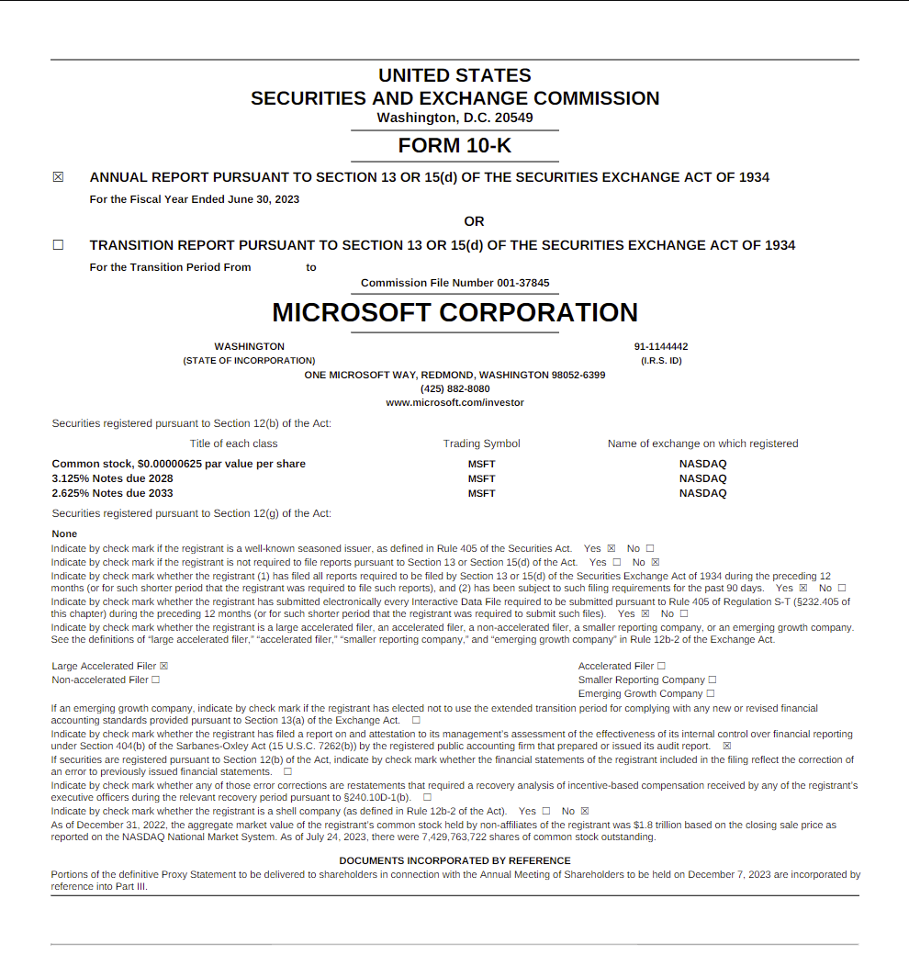
FSI - Dataset
Unstructured Data
Annual SEC report (Form 10-k) for the top 5 Tech company in NASDAQ (2020-2023)
Microsoft (MSFT)
Apple (AAPL)
Alphabet (GOOGL)
Amazon (AMZN)
Nvidia (NVDA)
Structured Data
5 years Stock price DB (Aug 2019/ Aug 2024)

Slide 11
FSI - Final Achievement (The QUESTIONS)
What are the revenues of GOOGLE in the year 2009?
Only answered by Vanilla model, as the data is not providing such information. from Challenge 2 step 2 the answer to this should be "I don't know" - as the LLM is grounded with provided documents.
What are the revenues and the operative margins of ALPHABET Inc. in 2022 and how it compares with the previous year?
Simple question with information present as text in the data provided. Should be more precise than with the vanilla model. Challenge 2 step 2 and next ones should provide the answer.
Can you create a table with the total revenue for ALPHABET, NVIDIA, MICROSOFT and APPLE in year 2023?
It needs a combinations of 4 different documents and ask the model to create a more complex answer (table). Challenge 2 step 2 and next ones should provide the answer.
Can you give me the Fiscal Year 2023 Highlights for APPLE, MICROSOFT and NVIDIA?
It needs a combinations of 3 documents and ask to summarize (this is more to show limitation of RAG compared with GraphRAG). Challenge 2 step 2 and next ones should provide the answer.

Slide 12
FSI - Final Achievement (The QUESTIONS)
Did APPLE repurchase common stock in 2023? create a table of APPLE repurchased stock with date, numbers of stocks and values in dollars.
It requires the interpretation of different tables in the document. It requires Document intelligence. Correct answer only in Challenge 4 and next ones.
What is the value of the cumulative 5-years total return of ALPHABET Class A at December 2022?
Requires analysis of an image (as the answer is not present in text.). Correct answer in Challenge 4 and next ones.
What was the price of APPLE, NVIDIA and MICROSOFT stock in 23/07/2024?
Requires the Stock Agent attached to SQL. Correct answer in Challenge 5 and next ones.
Can you buy 10 shares of APPLE for me?
Requires the Action Agent. Correct answer in Challenge 6 and next ones.

Slide 13
Dataset
Bring your data

Slide 14
Bring your data - Dataset
Unstructured Data
Your dataset should provide
Only PDFs (words and excels can be converted)
PDFs must be searchable and not scanned
Files must be less than 10Mb each (custom library limitation)
Structured Data (Optional – Required for Challenge 5)
Simple SQL DB with few tables and/or views.
Note: If no Structured data is provided, you can run Challenge 1,2,3,4,6,7 or Challenge 1,2,3,4,7

Slide 15
Bring Your data - Final Achievement (The QUESTIONS)
When you bring your own data, you need to define the set of questions based on it.
Question 1:
Only answered by Vanilla model, as the data is not providing such information. from Challenge 2 step 2 the answer to this should be "I don't know" - as the LLM is grounded with provided documents.
Question 2:
Simple question with information present as text in the data provided. Should be more precise than with the vanilla model. Challenge 2 step 2 and next ones should provide the answer.
Question 3:
It needs a combinations of different documents and ask the model to create a more complex answer (table). Challenge 2 step 2 and next ones should provide the answer.
Question 4:
It needs a combinations of documents and ask to summarize (this is more to show limitation of RAG compared with GraphRAG). Challenge 2 step 2 and next ones should provide the answer.
Question 5:
Requires analysis of an image (as the answer is not present in text.). Correct answer in Challenge 4 and next ones.
Question 6 (Optional – only if structured data are present):
Requires the Agent attached to SQL. Correct answer in Challenge 5 and next ones.
Question 7 (Optional – only if Action Agent is present):
Requires the Action Agent. Correct answer in Challenge 6 and next ones.

Slide 16
Let’s Start!
Good Luck

Slide 17

The Repo
https://github.com/francesco-sodano/itsarag

Slide 18
Challenge 0
Learn the Basics

Slide 19
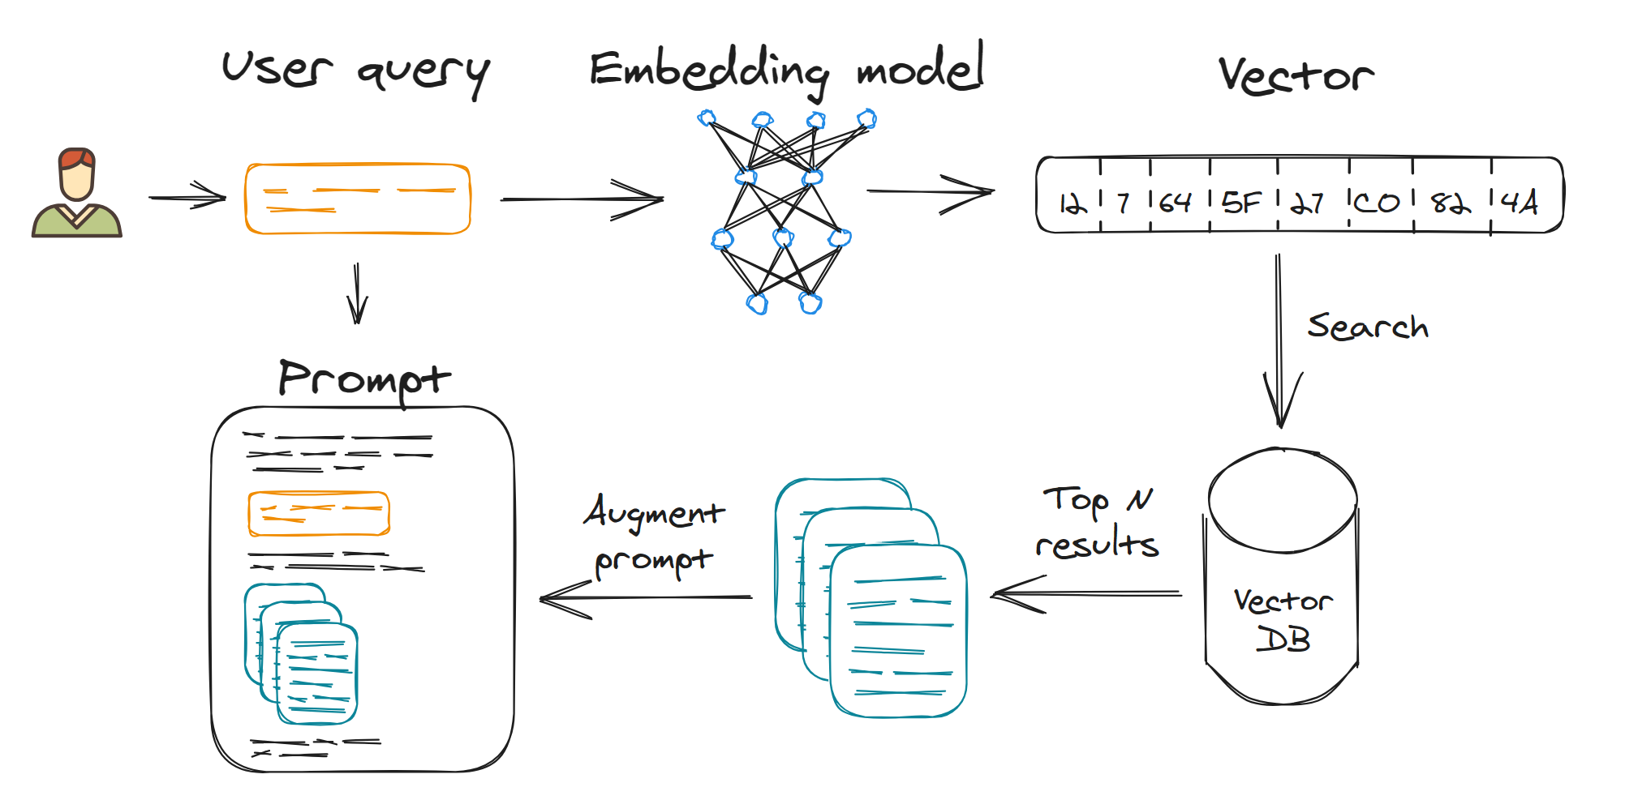
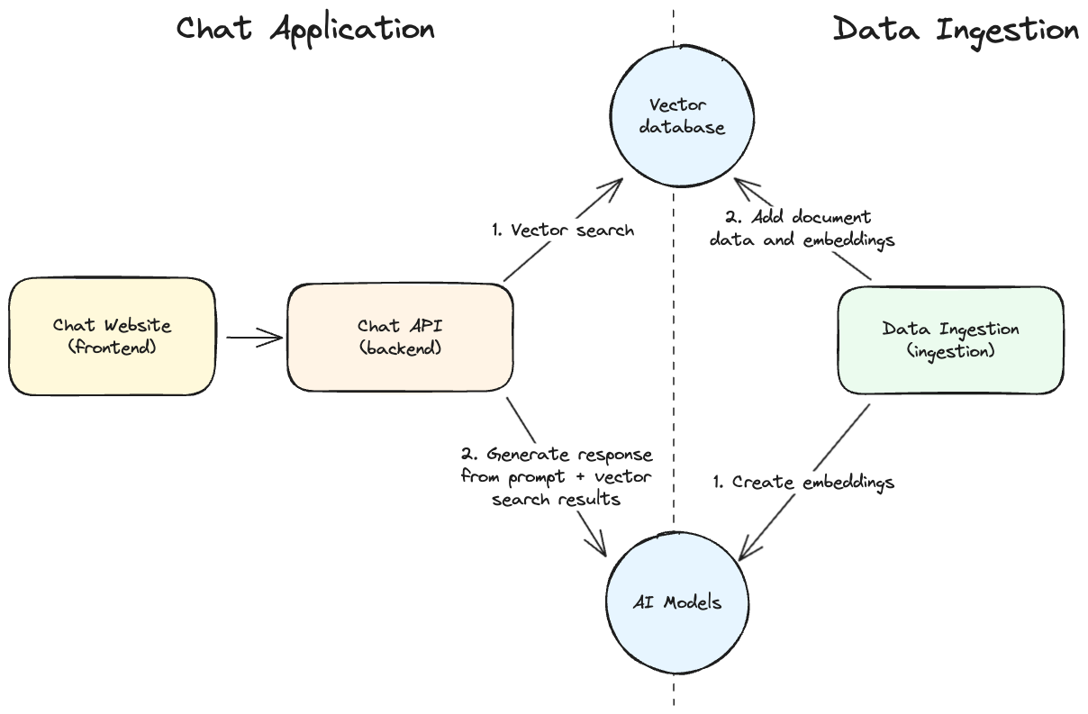
Challenge 0 - Introduction
Challenge 0 – Learn the Basics
Challenge 1 – Establish your Plan
This Challenge is just a recap of some notions you should have regarding Artificial Intelligence, RAG architecture and flow
Challenge 2 – Play with Azure AI Foundry
Challenge 3 – Start Coding
Challenge 4 – Advanced RAG
Challenge 5 – Multi-Source / Multi-Agent
Challenge 6 – Actions
Challenge 7 – Deploy your App

Slide 20
Challenge 0 - Challenge
Challenge 0 – Learn the Basics
Challenge 1 – Establish your Plan
Your challenge is to understand the basic concepts and the high-level architecture of a RAG application: what are the main components, how they interact with each other, and what technologies can be used to build them.
Also think about the following aspects:
How is the quality of the answers affected by the quality and the organization of the underlying data?
How will the chunking strategy affect the quality of the answers?
Is RAG a good solution for all the use cases? Where does RAG fall short? Where does it excel?
How do you compare RAG with a Fine-tuning LLM?
Challenge 2 – Play with Azure AI Foundry
Challenge 3 – Start Coding
Challenge 4 – Advanced RAG
Challenge 5 – Multi-Source / Multi-Agent
Challenge 6 – Actions
Challenge 7 – Deploy your App

Slide 21
Challenge 0 – Success Criteria
Challenge 0 – Learn the Basics
Challenge 1 – Establish your Plan
Challenge 2 – Play with Azure AI Foundry
Explain to your coach the main components of a RAG application and how they interact with each other
Describe the role of chunking and embedding in a RAG application
Describe at least one case where RAG would be a good solution and one case where it would not be the best choice
Challenge 3 – Start Coding
Challenge 4 – Advanced RAG
Challenge 5 – Multi-Source / Multi-Agent
Challenge 6 – Actions
Challenge 7 – Deploy your App

Slide 22
Challenge 1
Establish Your Plan

Slide 23
Challenge 1 - Introduction
Challenge 0 – Learn the Basics
Challenge 1 – Establish your Plan
After you learn the basics about generative AI, tools, and models, it's time to start building AI applications using the power of RAG (Retrieval Augmented Generation). 🤖 + 📚 = 🔥
In this Hackathon, you will go through a series of challenges to learn how to build RAG apps on top of the Azure platform.
At the end, you will produce a complete application ready to scale using an agentic multi-model RAG.
Challenge 2 – Play with Azure AI Foundry
Challenge 3 – Start Coding
Challenge 4 – Advanced RAG
Challenge 5 – Multi-Source / Multi-Agent
Challenge 6 – Actions
Challenge 7 – Deploy your App

Slide 24
Challenge 1 - Challenge
Challenge 0 – Learn the Basics
Challenge 1 – Establish your Plan
This challenge is all related to Prepare your development environment and Deploy your initial infrastructure for the Hackathon.
The challenge is composed by the following steps:
Step 1: Prepare your development environment
Step 2: Deploy Azure AI Foundry resources
Step 3: Update the ENV file with the necessary information
Step 4: Deploy the final infrastructure (Optional - can be done later after Challenge 5)
Challenge 2 – Play with Azure AI Foundry
Challenge 3 – Start Coding
Challenge 4 – Advanced RAG
Challenge 5 – Multi-Source / Multi-Agent
Challenge 6 – Actions
Challenge 7 – Deploy your App
We **Strongly** recommend using devcontainer as your development environment

Slide 25
Challenge 1 – Success Criteria
Challenge 0 – Learn the Basics
Challenge 1 – Establish your Plan
Challenge 2 – Play with Azure AI Foundry
Challenge 3 – Start Coding
You have prepared your development environment using devcontainers.
You have created a new environment in Python and installed the required libraries.
You have deployed Azure AI Studio resources.
Challenge 4 – Advanced RAG
Challenge 5 – Multi-Source / Multi-Agent
Challenge 6 – Actions
Challenge 7 – Deploy your App

Slide 26
Challenge 2
Play with Azure AI Foundry

Slide 27
Challenge 2 - Introduction
Challenge 0 – Learn the Basics
Challenge 1 – Establish your Plan
In this challenge, you will interact with Azure AI Foundry, a web portal that consolidates various Azure AI services into a single, cohesive development environment. From here you will be able to deploy models and infer with the vanilla models in the Playground.
After that, you will add some of the data provided in the dataset and perform some queries to the models.
The two models that you will interact with are:
Azure OpenAI GPT4o
Phi-3-medium-128k-instruct (if available)
Challenge 2 – Play with Azure AI Foundry
Challenge 3 – Start Coding
Challenge 4 – Advanced RAG
Challenge 5 – Multi-Source / Multi-Agent
Challenge 6 – Actions
Challenge 7 – Deploy your App

Slide 28
Challenge 2 - Challenge
Challenge 0 – Learn the Basics
Challenge 1 – Establish your Plan
This challenge focuses on using the Azure AI Foundry to interact with the models and the data provided in the dataset.
The challenge is composed of the following steps:
Step 1: Create a Project in Azure AI Foundry
Step 2: Deploy the required LLM Models
Step 3: Use the Azure AI Foundry Playground with the vanilla models
Step 4: Deploy the additional required services
Step 5: Add some of the data provided in the dataset and perform some queries on the models
Step 6: Use the Azure AI Foundry Playground with the new data
Challenge 2 – Play with Azure AI Foundry
Challenge 3 – Start Coding
Challenge 4 – Advanced RAG
Challenge 5 – Multi-Source / Multi-Agent
Challenge 6 – Actions
Challenge 7 – Deploy your App

Slide 29
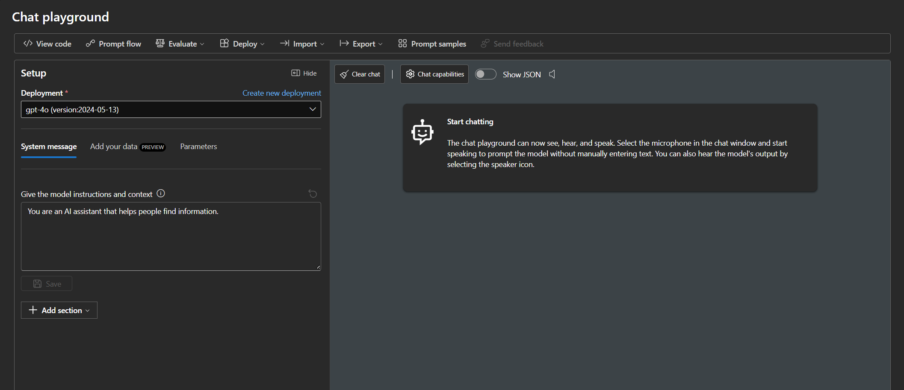
Challenge 2 – Success Criteria
Challenge 0 – Learn the Basics
Challenge 1 – Establish your Plan
You have the Azure AI Studio fully operational with vanilla models and with the ability of adding your own data.
You have answered all the questions provided and are able to explain the behavior to the coaches.
Challenge 2 – Play with Azure AI Foundry
Challenge 3 – Start Coding
Challenge 4 – Advanced RAG
Challenge 5 – Multi-Source / Multi-Agent
Challenge 6 – Actions
Challenge 7 – Deploy your App

Slide 30
Challenge 3
Start Coding

Slide 31
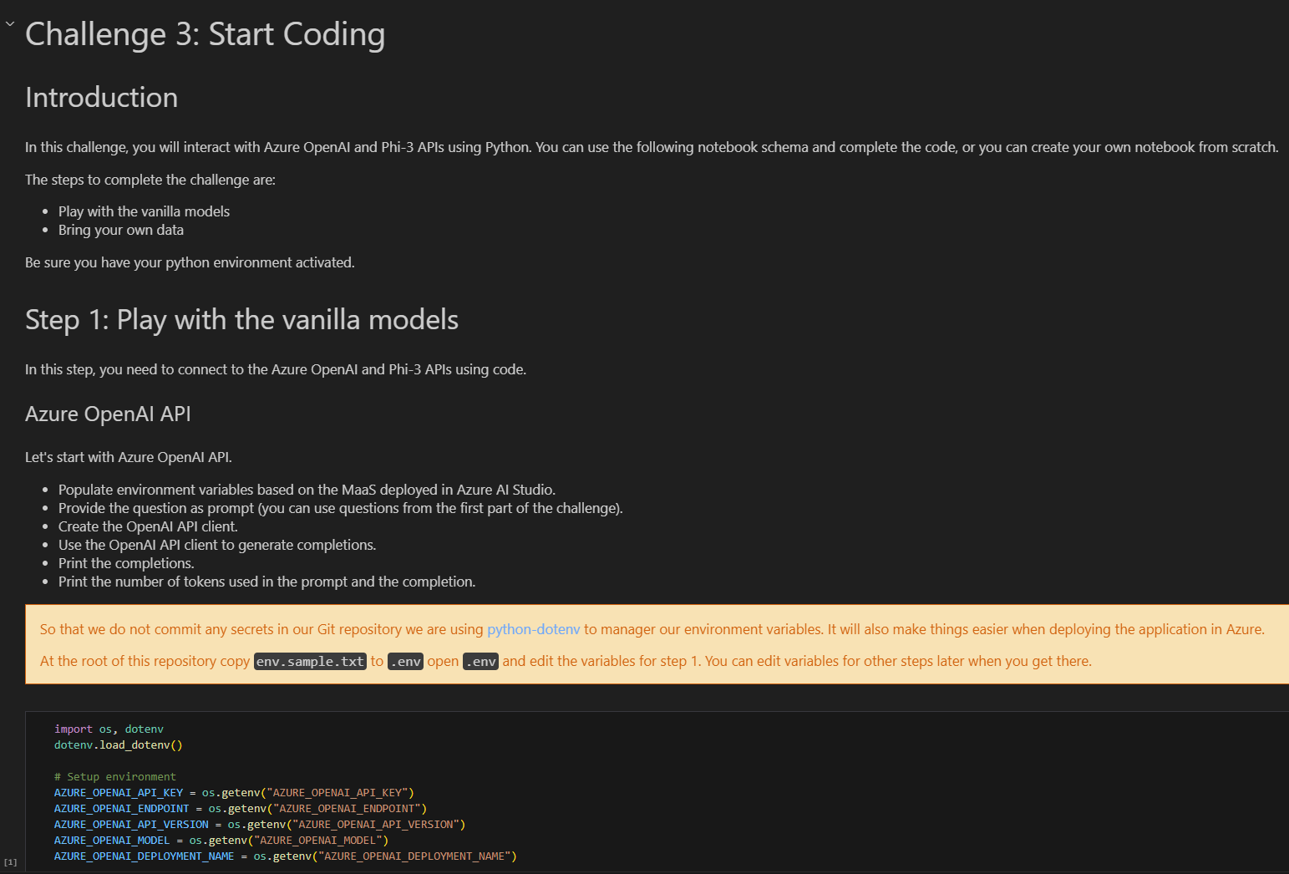
Challenge 3 - Introduction
Challenge 0 – Learn the Basics
Challenge 1 – Establish your Plan
In this challenge, you will interact with a Jupyter Notebook and interact with the models using Python and APIs.
In the first part, you will perform some inferences with the vanilla models, you will add some of the data provided in the dataset and perform some queries to the models.
Challenge 2 – Play with Azure AI Foundry
Challenge 3 – Start Coding
Challenge 4 – Advanced RAG
Challenge 5 – Multi-Source / Multi-Agent
Challenge 6 – Actions
Challenge 7 – Deploy your App

Slide 32
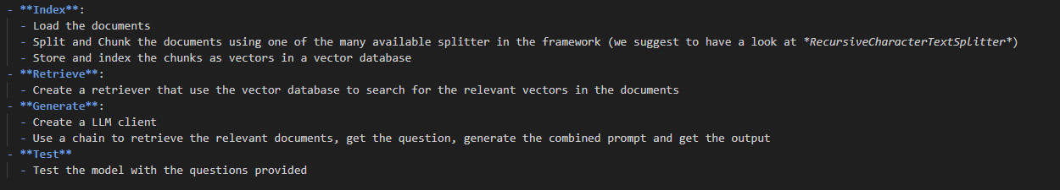
Challenge 3 - Challenge
Challenge 0 – Learn the Basics
Challenge 1 – Establish your Plan
Open the Jupyter Notebook provided
Follow the instructions in the notebook to complete the challenge
Play with the vanilla models
Add some of the data provided in the dataset and perform some queries to the models
Challenge 2 – Play with Azure AI Foundry
Challenge 3 – Start Coding
Challenge 4 – Advanced RAG
Challenge 5 – Multi-Source / Multi-Agent
Challenge 6 – Actions
Challenge 7 – Deploy your App

Slide 33

Challenge 3 – Success Criteria
Challenge 0 – Learn the Basics
Challenge 1 – Establish your Plan
You asked the same set of questions provided in Challenge 2.
You have the answers provided by the vanilla models.
You have answers provided by the RAG. If the answer was not in the context provided, the solution report is "I don't know".
Challenge 2 – Play with Azure AI Foundry
Challenge 3 – Start Coding
Challenge 4 – Advanced RAG
Challenge 5 – Multi-Source / Multi-Agent
Challenge 6 – Actions
Challenge 7 – Deploy your App

Slide 34
Challenge 4
Advanced RAG with Azure AI Document Intelligence

Slide 35
Challenge 4 - Introduction
Challenge 0 – Learn the Basics
Challenge 1 – Establish your Plan
As the basic RAG could be a good exercise to understand the basic concepts, many documents in a real scenario, are not just text: they are a combination of text, images, tables, etc.
In this challenge, you will create a more advanced RAG application able to deal with these kinds of documents.
For this reason, you will use Azure AI Document Intelligence to extract the text, images, and tables from the documents and use them as input for the RAG model.
Challenge 2 – Play with Azure AI Foundry
Challenge 3 – Start Coding
Challenge 4 – Advanced RAG
Challenge 5 – Multi-Source / Multi-Agent
Challenge 6 – Actions
Challenge 7 – Deploy your App

Slide 36
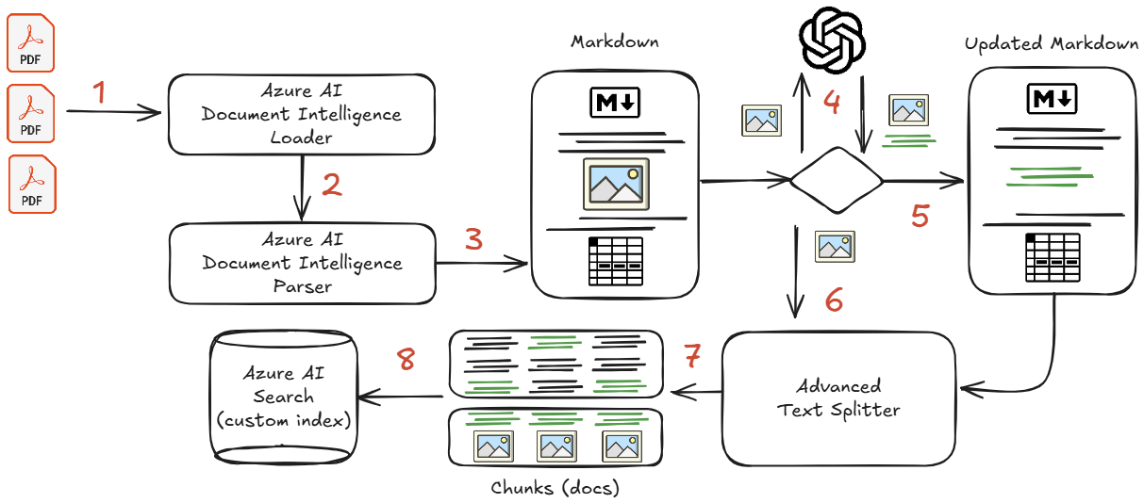
Challenge 4 – ITSARAG Libraries
Challenge 0 – Learn the Basics
Challenge 1 – Establish your Plan
Even if Langchain includes a document loader for Azure AI Document Intelligence, the implementation is basic and does not include all the features required for a complex advanced RAG.
For this reason, we provided an enhanced version of the Azure AI Document Intelligence Classes as well as the Text Splitters and a custom index that you can use in this challenge for the Advanced RAG.
Challenge 2 – Play with Azure AI Foundry
Challenge 3 – Start Coding
Challenge 4 – Advanced RAG
Challenge 5 – Multi-Source / Multi-Agent
Challenge 6 – Actions
Challenge 7 – Deploy your App

Slide 37
Challenge 4 - Challenge
Challenge 0 – Learn the Basics
Challenge 1 – Establish your Plan
Challenge 2 – Play with Azure AI Foundry
This challenge is divided into two parts:
Part 1
Create the required additional resources
Part 2
Create the Advanced RAG solution in a notebook using the provided custom modules
Challenge 3 – Start Coding
Challenge 4 – Advanced RAG
Challenge 5 – Multi-Source / Multi-Agent
Challenge 6 – Actions
Challenge 7 – Deploy your App

Slide 38
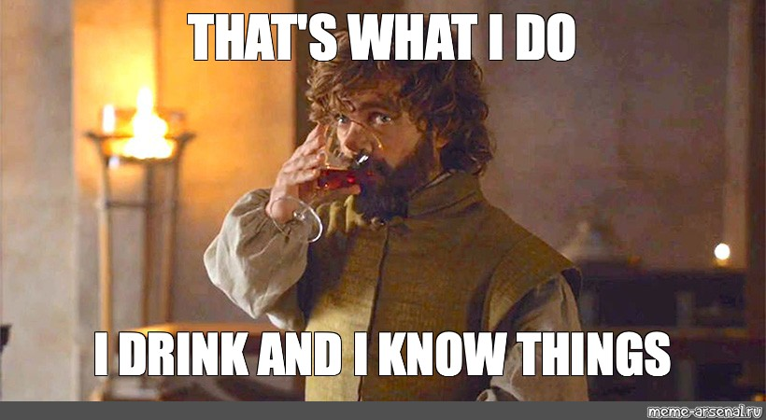
Challenge 4 – Success Criteria
Challenge 0 – Learn the Basics
Challenge 1 – Establish your Plan
You have a working Advanced RAG solution that works with multimodal prompt.
You are able to provide the answer for the proposed questions to the coach using your solution.
Challenge 2 – Play with Azure AI Foundry
Challenge 3 – Start Coding
Challenge 4 – Advanced RAG
Challenge 5 – Multi-Source / Multi-Agent
Challenge 6 – Actions
Challenge 7 – Deploy your App

Slide 39
Challenge 5
Multi-Source,
Multi-Agent

Slide 40
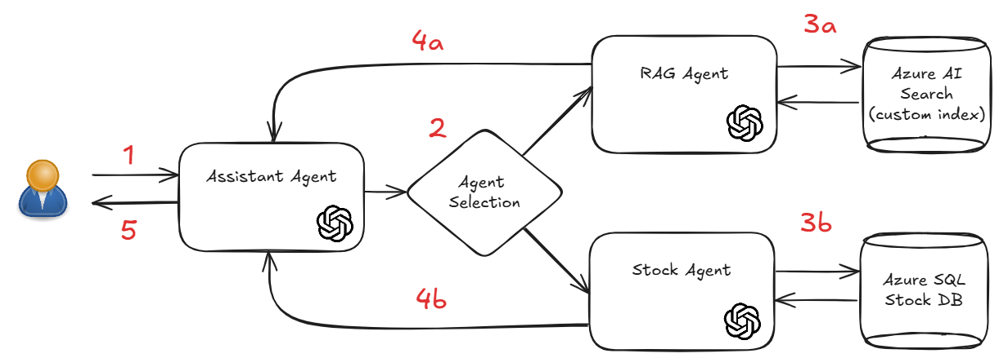
Challenge 5 - Introduction
Challenge 0 – Learn the Basics
Challenge 1 – Establish your Plan
Now that we have a working Advanced RAG solution, we can start adding additional features to our solution.
The best way to do this is to create a multi-agent architecture where each agent is responsible for a different task.
In this challenge, we will add another source of data to our solution: a SQL Database.
Challenge 2 – Play with Azure AI Foundry
Challenge 3 – Start Coding
Challenge 4 – Advanced RAG
Challenge 5 – Multi-Source / Multi-Agent
Challenge 6 – Actions
Challenge 7 – Deploy your App

Slide 41
Challenge 5 - Challenge
Challenge 0 – Learn the Basics
Challenge 1 – Establish your Plan
In this challenge, you will build on top of the previous one.
The advanced RAG solution you have created will be one of the node of the new multi-agent solution: the RAG agent.
You will now create a new agent, the Stock agent, that will be responsible for retrieving the answer from the SQL Database.
This challenge has three steps:
Step 1: Import data to the SQL Database
Step 2: Create a Langchain SQL Agent
Step 3: Create the Multi-Agent solution
Challenge 2 – Play with Azure AI Foundry
Challenge 3 – Start Coding
Challenge 4 – Advanced RAG
Challenge 5 – Multi-Source / Multi-Agent
Challenge 6 – Actions
Challenge 7 – Deploy your App

Slide 42

Challenge 5 – Success Criteria
Challenge 0 – Learn the Basics
Challenge 1 – Establish your Plan
You have a working Multi-Agent solution.
You are able to provide the answer for the proposed questions to the coach using your solution.
Challenge 2 – Play with Azure AI Foundry
Challenge 3 – Start Coding
Challenge 4 – Advanced RAG
Challenge 5 – Multi-Source / Multi-Agent
Challenge 6 – Actions
Challenge 7 – Deploy your App

Slide 43

Achievement Unlocked!

Slide 44
Challenge 6
Add Actions

Slide 45
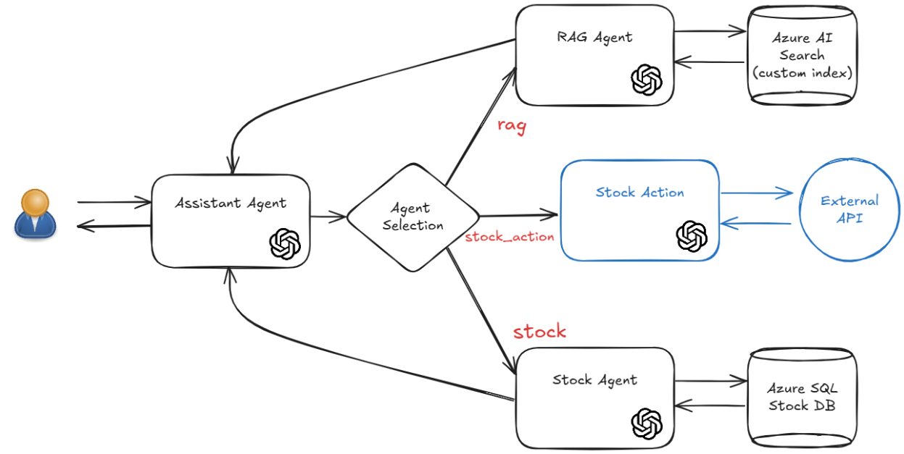
Challenge 6 - Introduction
Challenge 0 – Learn the Basics
Challenge 1 – Establish your Plan
In this challenge we will add an additional agent to our multi-agent solution: the Stock Action agent.
The Stock Action agent will be the first agent in this solution to not retrieve informtion but to perform action on behalf of the user.
Challenge 2 – Play with Azure AI Foundry
Challenge 3 – Start Coding
Challenge 4 – Advanced RAG
Challenge 5 – Multi-Source / Multi-Agent
Challenge 6 – Actions
Challenge 7 – Deploy your App

Slide 46
Challenge 6 - Challenge
Challenge 0 – Learn the Basics
Challenge 1 – Establish your Plan
You will now continue to build on top of what you did in the previous challenge.
You will now create a new agent, the Stock Action agent, that will be responsible for performing actions on the Stock API. You need also to modify the Assistant agent to be able to send the question to the Stock Action agent if the question is related to the Stock API and consequently also the LangGraph workflow.
Be sure that the Stock Action agent is able only to perform actions on the defined stocks.
Challenge 2 – Play with Azure AI Foundry
Challenge 3 – Start Coding
Challenge 4 – Advanced RAG
Challenge 5 – Multi-Source / Multi-Agent
Challenge 6 – Actions
Challenge 7 – Deploy your App

Slide 47

Challenge 6 – Success Criteria
Challenge 0 – Learn the Basics
Challenge 1 – Establish your Plan
You have a working Multi-Agent solution that includes the Stock Action agent.
You are able to provide the answer for the proposed questions to the coach using your solution.
Challenge 2 – Play with Azure AI Foundry
Challenge 3 – Start Coding
Challenge 4 – Advanced RAG
Challenge 5 – Multi-Source / Multi-Agent
Challenge 6 – Actions
Challenge 7 – Deploy your App

Slide 48
Challenge 7
Deploy your App

Slide 49
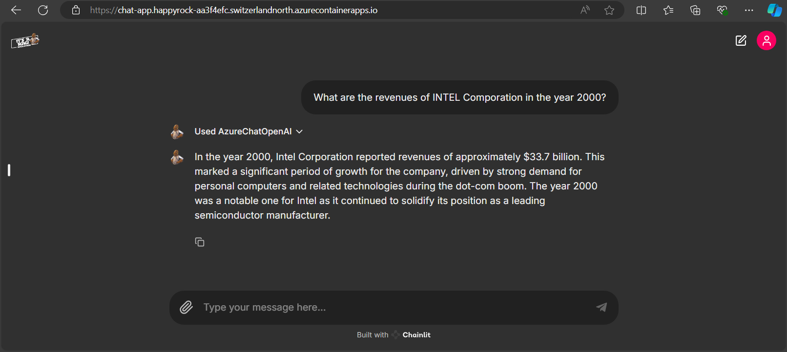
Challenge 7 - Introduction
Challenge 0 – Learn the Basics
Challenge 1 – Establish your Plan
Now that our solution is working in a Jupyter notebook,
we will create an app to deploy it and make it available to our users.
Challenge 2 – Play with Azure AI Foundry
Challenge 3 – Start Coding
Challenge 4 – Advanced RAG
Challenge 5 – Multi-Source / Multi-Agent
Challenge 6 – Actions
Challenge 7 – Deploy your App

Slide 50
Challenge 7 - Challenge
Challenge 0 – Learn the Basics
Challenge 1 – Establish your Plan
In this challenge, you will re-use what you have done in the previous one and
integrate the code in a web application providing a chat user interface.
Challenge 2 – Play with Azure AI Foundry
Challenge 3 – Start Coding
This challenge has these steps:
Step 0: Create the final Index with all Docs
Step 1: Deploy the sample code to Azure
Step 2: Get to know the sample code
Step 3: Let's test our code
Step 4: Integrate the assistant's code
Step 5: Deploy the code to Azure
Challenge 4 – Advanced RAG
Challenge 5 – Multi-Source / Multi-Agent
Challenge 6 – Actions
Challenge 7 – Deploy your App

Slide 51

Challenge 7 – Success Criteria
Challenge 0 – Learn the Basics
Challenge 1 – Establish your Plan
Your application is successfully deployed in Azure.
Your application gives _accurate_ answers to the sample questions provided in the application (click on the various questions and run them through the application).
Challenge 2 – Play with Azure AI Foundry
Challenge 3 – Start Coding
Challenge 4 – Advanced RAG
Challenge 5 – Multi-Source / Multi-Agent
Challenge 6 – Actions
Challenge 7 – Deploy your App

Slide 52
Achievement Unlocked!

Slide 53
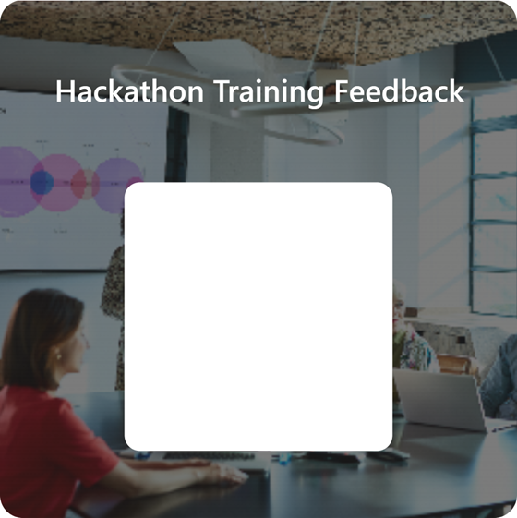

Let us know how it went!

Slide 54
Azure Pass
Demo Subscription

Slide 55
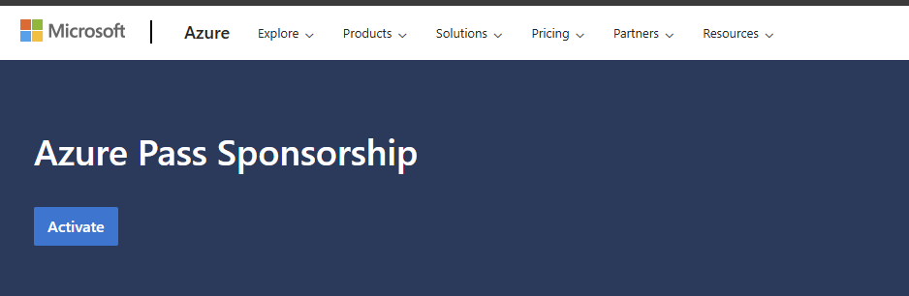
Redeem your Azure Pass Subscription
Go to the following link
https://azure.microsoft.com/en-us/pricing/offers/azure-pass
Review the Terms & Conditions

Slide 56
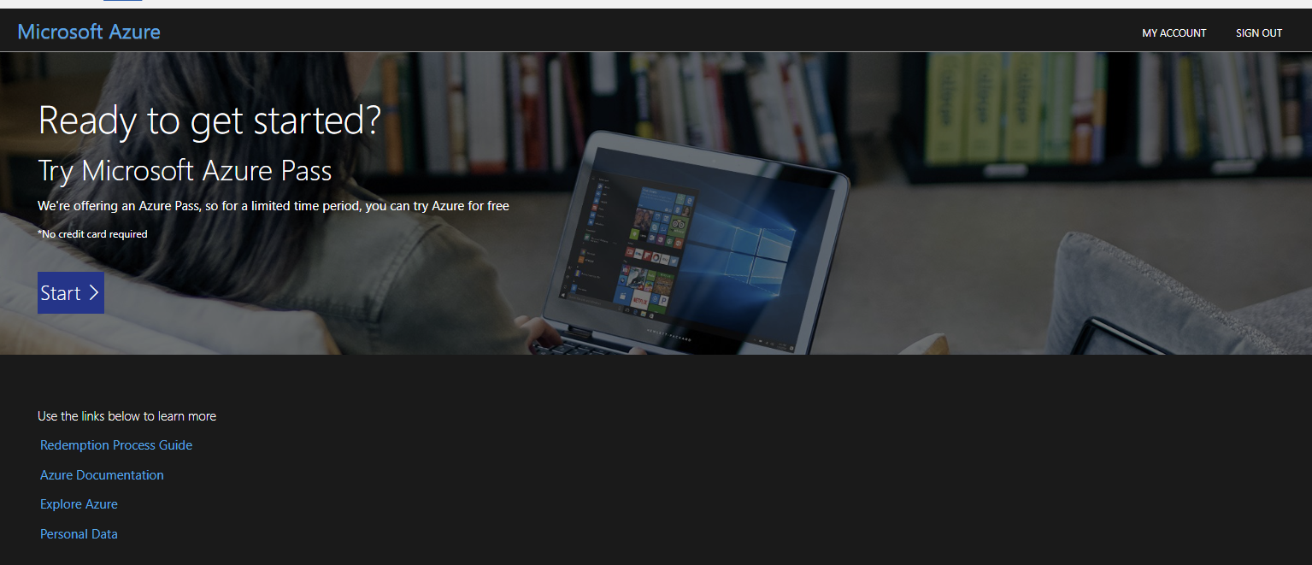
Redeem your Azure Pass Subscription
Make sure you’re logged in the right (enterprise / personal) account. Strongly recommended to use InPrivate Browsing / Edge Profiles
When hitting Start, you will be asked to confirm that the account is the right one

Slide 57
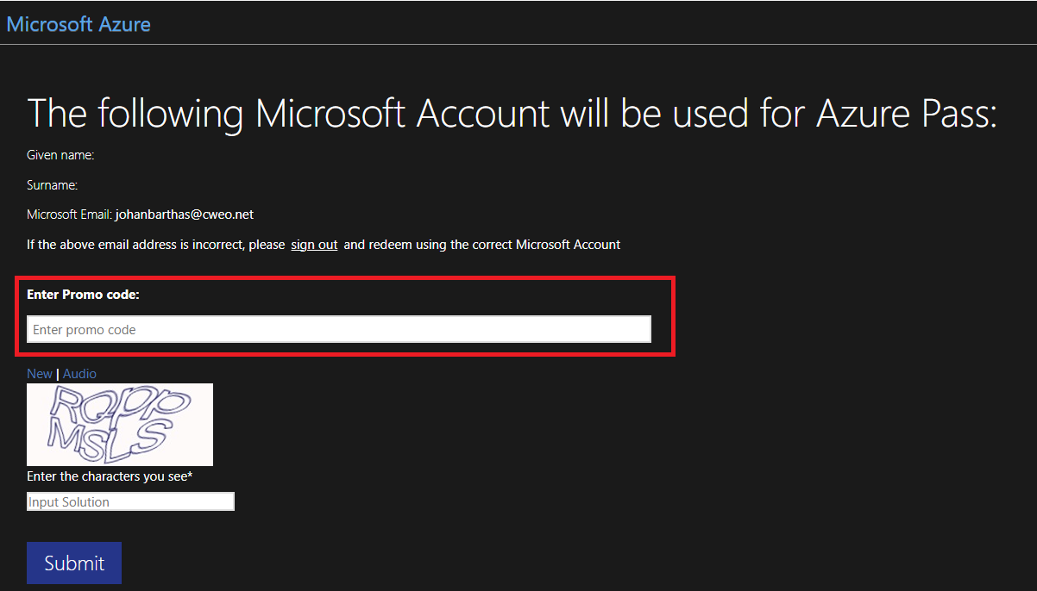
Redeem your Azure Pass Subscription
Proceed to enter the provided Azure Pass Code

Slide 58
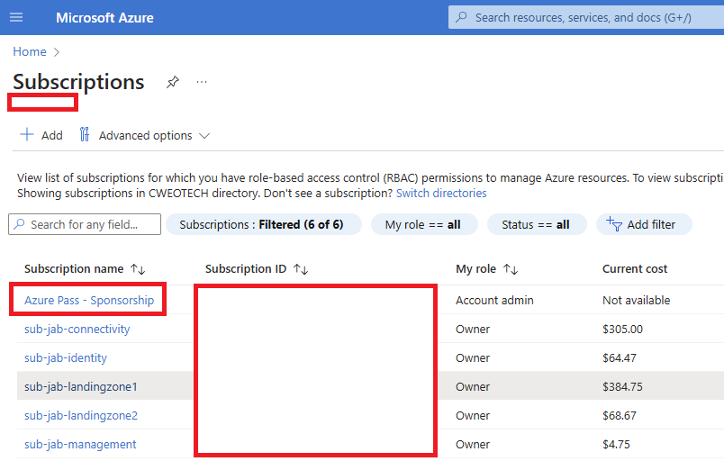
Redeem your Azure Pass Subscription
You should now see the Subscription in the Azure Portal

